Slide 1


Arbora
SMART SOLAR TREE · MVP
A tree that powers, measures and cools your city.
[Team name] · [Competition name] · 2026
Notes:
Open with the one-line idea: Arbora is a solar-powered smart tree for cities. It generates clean power, measures the air, removes some CO₂ with algae and plants, and gives shade and charging. Introduce the team and the competition.

Slide 2
Cities lack clean-air data, shade and public power at street level
THE PROBLEM
Little local air data
Little shade in summer
No public power
Reference-grade monitoring stations are expensive, so most neighborhoods get little or no local data.
Public spaces often lack shade, seating and a place to cool down during heat waves.
People cannot charge a phone outdoors, and clean energy stays out of sight.
Arbora · Smart solar tree
02
Notes:
Three everyday gaps in public space: air nobody measures locally, heat with no shade, and no power outdoors. Arbora addresses all three in one structure.

Slide 3
One structure, four jobs
THE CONCEPT
01
02
03
04
Generate
Measure
Remove
Serve
Solar canopy of about 1 kWp, with a battery for night use.
PM2.5, PM10, CO₂, temperature and humidity, shown live.
An algae bioreactor and plants take in CO₂ and release oxygen.
Shade, rain cover and benches with USB-C charging.
Later versions add advanced CO₂ conversion, cooling zones and day and night forms.
Arbora · Smart solar tree
03
Notes:
The core idea: combine four things cities usually buy separately. Power, air monitoring, CO₂ removal, and public comfort. The custom design means the canopy can take many shapes and carry local or sponsor branding.

Slide 4
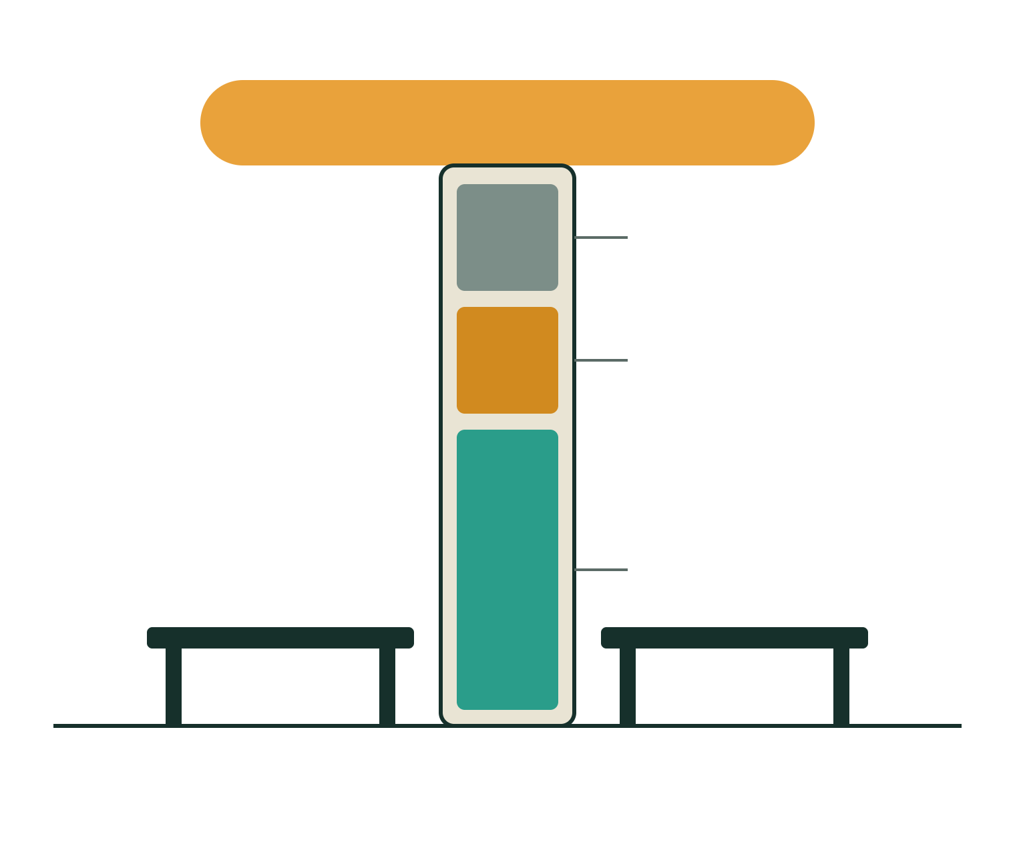
The MVP: a 3 m solar tree
Solar canopy, ~1 kWp
~3 m
Tall, with a ~3 m solar canopy
Air sensors
1 kWp + 2 kWh
Battery
Solar panels and battery in the trunk
100–200 L
Algae reactor
Algae bioreactor, plus plants and moss
$2.4–5.6k
Benches with USB-C charging
DIY hardware cost for the first prototype
Arbora · Smart solar tree
04
Notes:
This is the MVP we can build and show now. The advanced chemistry, air conditioning and origami transformations stay on the roadmap. A 400 to 600 W array is enough for the electronics alone if the budget is tight.

Slide 5

How the tree removes CO₂
HOW IT WORKS
1. Air in
2. Algae grow
3. Harvest
A small pump pushes air through the water as fine bubbles, and CO₂ dissolves.
With light, algae turn dissolved CO₂ into biomass and release oxygen, which vents out.
Harvested algae become fertilizer, biofuel or feed, so the carbon stays out of the air.
Carbon is only removed if the algae are harvested and used. Left to rot in the tank, they release the CO₂ again.
Arbora · Smart solar tree
05
Notes:
Explain the mechanism simply. CO₂ dissolves in water, algae fix it through photosynthesis and release oxygen. Be upfront that harvesting is what makes it a real removal. Air is only about 0.04 percent CO₂, so growth is slow; feeding in captured CO₂ later would speed it up.

Slide 6
Impact per tree, per year
ENVIRONMENTAL IMPACT
25–85 kg
~500 kg
1–4 trees
CO₂ removed by algae and plants
CO₂ avoided by solar power, at most, on an average grid*
Removal equal to real trees; up to 5–25 with avoided emissions
Arbora will not out-remove real trees. Its value is local data, clean power, shade and a visible example.
*Avoided emissions depend on the local grid and are much lower on a hydro-heavy grid like Kyrgyzstan’s. All figures are planning estimates; the MVP will measure real values.
Arbora · Smart solar tree
06
Notes:
Be precise about what is removal and what is avoided emissions. Removal by algae and plants is about 25 to 85 kg of CO₂ a year, roughly one to four mature trees at 20 to 25 kg each. Solar adds avoided emissions on top, which depend on the local grid. These are estimates and the sensors on the tree will replace them with measurements.

Slide 7
Where the real value is
BEYOND CARBON
Local air data
Live readings help residents, schools and planners see pollution where it happens.
Shade and rain cover
A cooler, drier place to sit, and the base for future cooling zones.
Public charging
Benches with USB-C draw on the tree’s own solar power.
A visible example
People see clean energy and clean air working in their own street.
Arbora · Smart solar tree
07
Notes:
This is the honest pitch. The strongest benefits are measured local air data, shade, charging and awareness. A network of trees becomes a dense, low-cost monitoring grid, which most cities lack.

Slide 8

Website now, apps next
CONNECTED
Tree sensors
Cloud database
Website
App
Website (MVP)
Apps (later)
Live air quality and history charts
Solar output and battery level
Impact counters, labeled measured or estimated
Map, about page and sponsor contact
Air alerts by push notification
Find shade, charging and clean-air spots
City-wide air map from many trees
Maintenance reports from residents
Arbora · Smart solar tree
08
Notes:
The tree sends its readings to a cloud database every minute or so, and the website reads from it. The apps can start as an installable web app, so there is no need to build separate iOS and Android versions first. Real, measured data makes the environmental claims credible.

Slide 9
What it costs to build and to buy
COST
Item | Cost (USD) | Note
DIY hardware | $2,400–5,600 | Own labor; a smaller solar array cuts it further
Professional prototype | $10,000–25,000 | Fabrication, software and engineering
Price, pilot units | $12,000–18,000 | First 1–10 units
Price at scale | $8,000–12,000 | 100 or more units
Sponsorship lease | $300–500 per month | Sponsor’s brand on the tree
Running costs | $300–800 per year | Cleaning, algae care, calibration
For comparison, a reference-grade air monitoring station alone typically costs $10,000–40,000. Figures are planning estimates; confirm with local supplier quotes.
Arbora · Smart solar tree
09
Notes:
The prototype can be built by the team for roughly 2,400 to 5,600 dollars in hardware. A professional version is 10,000 to 25,000. At pilot scale the unit could sell for 12,000 to 18,000, falling toward 8,000 to 12,000 with volume. A lease with a sponsor’s brand is easier for a city or company to approve than a large purchase.

Slide 10
Who it is for and how it earns
CUSTOMERS AND REVENUE
Customers
Revenue
City governments and public transport
Companies that sponsor a tree with their brand
Schools, universities, parks and malls
Purchase or monthly lease per tree
Sponsorship and branding
Air-data access for cities and researchers
CO₂ credits later, if stored carbon is verified
Arbora · Smart solar tree
10
Notes:
Cities buy through public procurement, companies through sponsorship. A hot summer makes a branded cooling spot attractive to a café or mall. The data service becomes more valuable as more trees join the network.

Slide 11
From MVP to full Arbora
ROADMAP
Version 1 · MVP
Version 2
Version 3 · Research
Custom canopy design
Sensors and website
Solar power and benches
Algae and plants
Sorbent CO₂ capture feeding the algae
Cooling zone with misting
Mobile app and alerts
Artificial photosynthesis: gallium-indium (ground)
Cobalt oxide and nickel-iron phosphate (sea)
Day and night origami forms
Next step: pilot one tree, measure real data, then scale.
Arbora · Smart solar tree
11
Notes:
Version 1 is what we show today. Version 2 adds the heavier modules once the electronics and data pipeline work. Version 3 is the research tier: the gallium-indium and cobalt and nickel-iron catalysts are promising in lab research but not yet proven at street scale, so they stay a goal.

Slide 12

Clean power, clean data, cooler streets
ARBORA
What we ask from this competition: [funding, a pilot site, mentors; fill in]
[Name] · [Email] · [Website]
Notes:
Close on the one-line promise, then the specific ask. Replace the bracketed text with what you want from the jury, for example a funding amount, a pilot location or mentoring, and your contact details.

